Slide 1
Introduction To Programming
Quicksort, Independent Reading

Slide 2
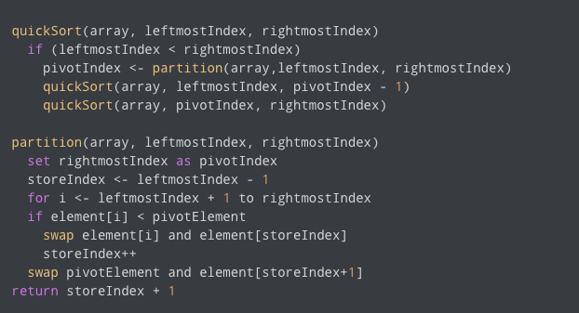
Quicksort Pseudo-code
(Source: https://www.programiz.com/dsa/quick-sort, 27.03.2022)

Slide 3
Yennefer’s Library v0.2
Expand upon last lesson’s code to support sorting books alphabetically.
We will be using quicksort for this – example code: quick_sort.c
ASCII values for sort purpose: https://www.asciitable.com/

Slide 4
Aticle 1 - ”Coding Sucks: Why A Job In Programming Is Absolute Hell ”
https://www.gizmodo.com.au/2014/05/programming-sucks-why-a-job-in-coding-is-absolute-hell/
This article is to help tackle “programming frustration” and to illustrate, that you are not alone in this struggle – the next two articles offer tips on how to tackle them best.
Read the article and write out 3 key insights to share with others next lesson.

Slide 5
Article 2 - Teach Yourself Programming in Ten Years
https://norvig.com/21-days.html
Provides a nice bucket of suggestions to learning programming
Read the article and write out 3 key insights to share with others next lesson.

Slide 6
Article 3 – “The law of leaky abstractions” and “Back to Basics”
https://www.joelonsoftware.com/2002/11/11/the-law-of-leaky-abstractions/
https://www.joelonsoftware.com/2001/12/11/back-to-basics/
Read the articles and write out 3 key insights to share with others next lesson.
Both articles highlight great reasons for the necessity to understand fundamental concepts.

